Slide 1

BITS, PILANI – K. K. BIRLA GOA CAMPUS
Operating Systems
(CS C372 & IS C362)
by
Mrs. Shubhangi Gawali
Dept. of CS and IS
September 16, 2013

Slide 2
OPERATING SYSTEMS
(CS C372 & IS C362)
LECTURE 16: CPU SCHEDULING

Slide 3
Linux Scheduling

Slide 4
Linux 2.4 scheduler - goals
Linux 2.4 scheduler provided real-time scheduling capability coupled with a scheduler for non-real-time processes
Good interactive performance even during high load
  If the user types or clicks then the system must react instantly and must execute the user tasks smoothly, even during considerable background load.
Fairness
  No process should stay without any timeslice for any unreasonable amount of time.
  No process should get an unjustly high amount of CPU time.
September 16, 2013
Notes:
Linux provided a real-time scheduling capability coupled
with a scheduler for non-real-time processes that made use of the traditional UNIX
scheduling algorithm.

Slide 5
Linux 2.4 scheduler - goals
Supports SMP: single runqueue, individual scheduler
SMP efficiency
  No CPU should stay idle if there is work to do.
SMP affinity
  Processes which run on one CPU should stay affine to that CPU.
  Processes should not bounce between CPUs too frequently.
September 16, 2013

Slide 6
The three Linux 2.4 scheduling classes
RT process is scheduled according to one of the following classes
  SCHED_FIFO: First-in-first-out real-time threads
  SCHED_RR: Round-robin real-time threads
    Non RT process (Conventional time shared process)
  SCHED_OTHER: Other, non-real-time threads
Within each class, multiple priorities may be used, with priorities in the real-time classes higher than the priorities for the SCHED_OTHER class.
September 16, 2013

Slide 7
SCHED_FIFO scheduling class
For FIFO threads, the following rules apply:
1. The system will not interrupt an executing FIFO thread except in the following cases:
  a. Another FIFO thread of higher priority becomes ready.
  b. The executing FIFO thread is blocked for an I/O.
  c. The executing FIFO thread voluntarily gives up the processor.
2. When an executing FIFO thread is interrupted, it is placed in the queue associated with its priority.
3. If more than one thread has that highest priority, the thread that has been waiting the longest is chosen.
September 16, 2013

Slide 8
SCHED_RR scheduling class
The SCHED_RR policy is similar to the SCHED_FIFO policy, except for the addition of a timeslice associated with each thread.
When a SCHED_RR thread has executed for its timeslice, it is suspended and a real-time thread of equal or higher priority is selected for running.
September 16, 2013

Slide 9
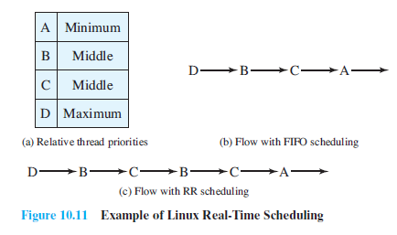
Real time scheduling example in Linux 2.4
September 16, 2013

Slide 10
Drawbacks of Linux 2.4 scheduler :
  Scheduler for the SCHED_OTHER class did not scale well with increasing number of processors and increasing number of processes.
  The scheduler uses a single runqueue for all processors in a symmetric multiprocessing system (SMP) (good for load balancing but bad for memory caches)
  Uses a single runqueue lock.
  Preemption is not possible.
September 16, 2013
Notes:
The Linux 2.4 scheduler uses a single runqueue lock.Thus, in an SMP system,
the act of choosing a task to execute locks out any other processor from manipulating
the runqueues. The result is idle processors awaiting release of the
runqueue lock and decreased efficiency.
• Preemption is not possible in the Linux 2.4 scheduler; this means that a
lower-priority task can execute while a higher-priority task waited for it to
complete.

Slide 11
Linux Scheduling
O(1) scheduler

Slide 12
Evolution of Linux schedulers
Linux 2.4 scheduler | Linux 2.6 O(1) scheduler
SMP with Single run queue, lacks scalability | SMP with individual run queue
Single run queue | Two queues (active and expiry)
Selection takes O(N) time as it iterates over every process | Selection take constant time (O(1)) as from priority queue, dequeue the next from active runqueue
Inefficient and weak for real time system | Much more efficient and much more scalable.
Priority of the process is fixed (Static priority) | Priority changes as per cpu usage. Static and dynamic priority. Incorporated interactivity metrics with numerous heuristics to determine whether the process was I/O bound or processor bound
September 16, 2013

Slide 13
O(1) scheduler in Linux 2.6
To correct these problems, Linux 2.6 uses the O(1) scheduler.
The scheduler is designed so that the time to select the appropriate process and assign it to a processor is constant,
  regardless of the load on the system or the number of processors.
September 16, 2013

Slide 14
O(1) scheduler in Linux 2.6
Preemptive priority based round robin scheduler
Two separate priority ranges:
  Real time range : 0 to 99
  Nice value range: 100 to 139
These two ranges map into global priority scheme.
Higher priority task : larger time quanta
Lower priority task : smaller time quanta
September 16, 2013

Slide 15
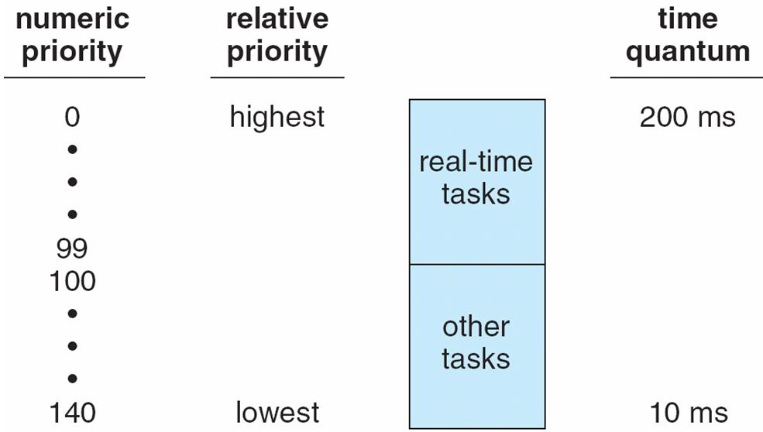
The Relationship Between Priorities and Time-slice length
139
September 16, 2013

Slide 16
Data structure
The kernel maintains two scheduling data structure for each processor in the system, of the following form
struct prio_array {
int nr_active; /* number of tasks in this array*/
unsigned long bitmap[BITMAP_SIZE]; /* priority bitmap */
struct list_head queue[MAX_PRIO]; /* priority queues */
Two such structures are maintained:
  an active queues structure and
  an expired queues structure.
A separate queue is maintained for each priority level.
September 16, 2013
Notes:
The kernel maintains two scheduling data structure for each processor in the
system, of the following form
The total number of queues in the structure is MAX_PRIO, which has a default value of 140.
The structure also includes a bitmap array of sufficient size to provide one bit per priority level.
The bitmap indicates which queues are not empty.
nr_active indicates the total number of tasks present on all queues.

Slide 17
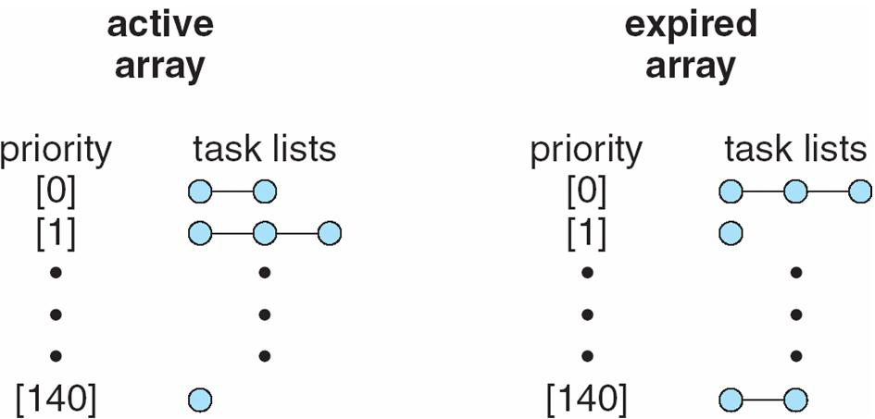
List of Tasks Indexed According to Prorities
[139 ]
[139 ]
September 16, 2013

Slide 18
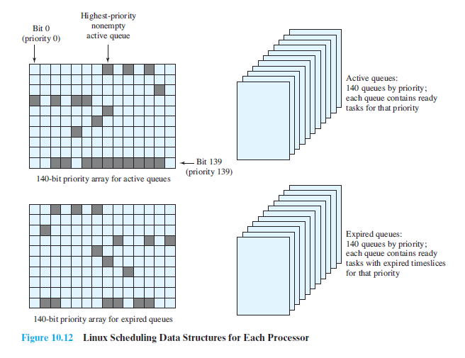
September 16, 2013

Slide 19
O(1) scheduling algorithm in Linux 2.6
Initially, both bitmaps are set to all zeroes and all queues are empty.
As a process becomes ready, it is assigned to the appropriate priority queue in the active queues structure and is assigned the appropriate timeslice.
Possibilities:
  If the running process is preempted before its timeslice, it is returned to an active queue.
  When a task completes its timeslice, it goes into the appropriate queue in the expired queues structure and is assigned a new timeslice.
  If the running process goes for I/O , priority (dynamic) is recomputed and the process is added to the appropriate active queue.
September 16, 2013

Slide 20
O(1) scheduling algorithm in Linux 2.6 contd..
All scheduling is done from among tasks in the active queues structure.
When the active queues structure is empty, a simple pointer assignment results in a switch of the active and expired queues, and scheduling continues.
On a given processor, the scheduler picks the highest-priority nonempty queue. If multiple tasks are in that queue, the tasks are scheduled in round-robin fashion.
September 16, 2013
Notes:
Linux also includes a mechanism for moving tasks from the queue lists of
one processor to that of another. Periodically, the scheduler checks to see if there
is a substantial imbalance among the number of tasks assigned to each processor.
To balance the load, the schedule can transfer some tasks.The highest priority active
tasks are selected for transfer, because it is more important to distribute highpriority
tasks fairly.

Slide 21
Calculating Priority of a process
Each non-real-time task is assigned an initial priority in the range of 100 to 139, with a default of 120.This is the task’s static priority and is specified by the user.
As the task executes, a dynamic priority is calculated as a function of the task’s static priority and its execution behavior.
The Linux scheduler is designed to favor I/O-bound tasks over processor-bound tasks. This preference tends to provide good interactive response.
The technique used by Linux to determine the dynamic priority is to keep a running tab on how much time a process sleeps (waiting for an event) versus how much time the process runs.
In essence, a task that spends most of its time sleeping is given a higher priority.
September 16, 2013

Slide 22
Calculating Static Priority of a process from Nice value
  nice() or setpriority() system calls
    Changes the static priority of the process
  /*Convert user-nice values [ -20 ... 0 ... 19 ] to static priority [ MAX_RT_PRIO..MAX_PRIO-1 ], and back */
  #define NICE_TO_PRIO(nice)
  (MAX_RT_PRIO + (nice) + 20)
  #define PRIO_TO_NICE(prio)
  ((prio) - MAX_RT_PRIO - 20)
September 16, 2013

Slide 23
Calculating Time slice of a process
Time slices are assigned in the range of 10 ms to 200 ms.
In general, higher priority tasks are assigned larger time slices.
A new process will always inherit the static priority of its parent.
User can change the static priority of the process by nice() or setpriority() system calls
September 16, 2013

Slide 24
Calculating Time slice from static priority
Static priority determines the base time quantum of a process
Base time quantum (in milliseconds)
  (140 – static priority) X 20 if static priority <120
  (140 – static priority) X 5 if static priority >=120
  The higher the static priority (lower value), the longer the base time quantum
  Example
  Description static priority base time quantum
  Highest static priority 100 800ms
  Default static priority 120 100ms
  Lowest static priority 139 5ms
September 16, 2013

Slide 25
Dynamic priority
In Linux, process priority is dynamic.
The scheduler keeps track of what processes are doing and adjusts their priorities periodically.
DP is recalculated when q expires and process is moved to expired array, also when process sleeps
In this way, processes that have been denied the use of the CPU for a long time interval are boosted by dynamically increasing their priority.
Correspondingly, processes running for a long time are penalized by decreasing their priority.
September 16, 2013

Slide 26
Average Sleep Time | Bonus | Granularity
Greater than or equal to 0 but smaller than 100ms | 0 | 5120
Greater than or equal to 100ms but smaller than 200ms | 1 | 2560
Greater than or equal to 200ms but smaller than 300ms | 2 | 1280
Greater than or equal to 300ms but smaller than 400ms | 3 | 640
Greater than or equal to 400ms but smaller than 500ms | 4 | 320
Greater than or equal to 500ms but smaller than 600ms | 5 | 160
Greater than or equal to 600ms but smaller than 700ms | 6 | 80
Greater than or equal to 700ms but smaller than 800ms | 7 | 40
Greater than or equal to 800ms but smaller than 900ms | 8 | 20
Greater than or equal to 900ms but smaller than 1000ms | 9 | 10
1 second | 10 | 10
September 16, 2013

Slide 27
Calculating Dynamic Priority based on avg sleep time
Dynamic priority value ranges from 100 (highest priority) to 139 (lowest priority)
Dynamic priority is the one scheduler looks at when selecting a new process to run
  Dynamic priority =
  max (100, min(static priority – bonus + 5, 139))
  Bonus is ranging from 0 to 10
    Less than 5 (is a penalty that) lowers dynamic priority
    Greater than 5 raises dynamic priority
  Value of bonus depends on the past history of the process (related to average sleep time of the process)
    Average sleep time reduces when process is running
    Average sleep can never become larger than 1 second
    Average sleep time increases when process is in I/O
September 16, 2013

Slide 28
Relationship to Real-Time Tasks
The following considerations apply:
1. All real-time tasks have only a static priority;
no dynamic priority changes are made.
2. SCHED_FIFO tasks do not have assigned timeslices.
Such tasks are scheduled in FIFO discipline.
If a SCHED_FIFO task is blocked, it returns to the same priority
queue in the active queue list when it becomes unblocked.
3. Although SCHED_RR tasks do have assigned timeslices, they also are never moved to the expired queue list.
When a SCHED_RR task exhaust its timeslice, it is returned to its priority queue with the same timeslice value.
Timeslice values are never changed.
The effect of these rules is that the switch between the active queue list and the expired queue list only happens when there are no ready real-time tasks waiting to execute.
September 16, 2013
Notes:
Real-time tasks are handled in a different
manner from non-real-time tasks in the priority queues.

Slide 29
A real time process is replaced by another only when one of the following events occur
  Process is preempted by a higher real time priority process
  Process performs blocking operation (TASK_ INTERRUPTABLE or TASK_UNINTERRUPTABLE)
  Process is stopped (TASK_STOPPED or TASK_TRACED)
  Process is killed (EXIT_ZOMBIE or EXIT_DEAD)
  Process voluntarily relinquishes the CPU by invoking sched_yield() system call
  The process is Round Robin real time (SCHED_RR) and it has exhausted its time quantum
September 16, 2013

Slide 30
System Calls Related to Scheduling
nice( ) Change the priority of a conventional process.
getpriority( ) Get the maximum priority of a group of conventional processes.
setpriority( ) Set the priority of a group of conventional processes.
sched_getscheduler( ) Get the scheduling policy of a process.
sched_setscheduler( ) Set the scheduling policy and priority of a process.
sched_getparam( ) Get the scheduling priority of a process.
sched_setparam( ) Set the priority of a process.
sched_yield( ) Relinquish the processor voluntarily without blocking.
sched_get_ priority_min( ) Get the minimum priority value for a policy.
sched_get_ priority_max( ) Get the maximum priority value for a policy.
sched_rr_get_interval( ) Get the time quantum value for the Round Robin policy.
September 16, 2013

Slide 31
Exercise
Process | Nice | Execution Time(ms) | Sleep time(ms) | Real Time Priority | Sched policy
A | 8 | 50 | 0 | - | SCHED_OTHER
B | -15 | 800 | 0 | - | SCHED_OTHER
C | -5 | 600 | - | 30 | SCHED_RR
D | 0 | 100 | - | 30 | SCHED_FCFS
A Linux OS supporting O(1) Scheduler has this snapshot at time t. Assume that the order of arrival of processes to the system is Process A to Process D. Process A and B are Conventional processes and Process C and D are Real Time Processes.
Find Static Priority for all the processes.
Find Quantum time for all the processes.
Find Dynamic priority for all Conventional processes.
Find the resultant schedule and represent it as Gantt chart
September 16, 2013

